Slide 1

Xamarin Forms project structure
By Israel Calderón de la Cruz

Slide 2
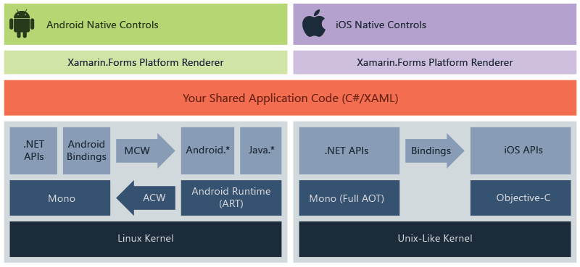
How works Xamarin.Forms

Slide 3



Native development
👨🏽‍💻 Android
👨🏽‍💻 iOS
👨🏽‍💻 UWP
Kotlin/Java
Compiler
Swift
Compiler
C#
Compiler

Slide 4



Execution flow
MainActivity
void OnCreate(Bundle savedInstanceState)
App
App() => InitializeComponent();
AppDelegate
FinishedLaunching(UIApplication app, NSDictionary options)

Slide 5
👨🏽‍💻 New project and review arquitecture
Notes:
Activity list
Fast review
- Create new xamarin forms project
- Review arquitecture app
- AppDelegate
- MainActivity
- AndroidManifest
- Info.plist
- Android Resources (drawable, styles etc.)
- iOS Resources ( Assets )
Changes
- Configure app name
- Configure default icon

